Slide 1

Explanatory Analysis of Wildfires Occurrence

Slide 2
Introduction

Slide 3
Introduction
In 50% of wildfires recorded, it is not known how they started. he risk of wildfires increases in extremely dry conditions, such as drought, and during high winds.
Wildfires and volcanic activities affected 6.2 million people between 1998-2017 with 2400 attributable deaths worldwide from suffocation, injuries, and burns, but the size and frequency of wildfires are growing due to climate change.
Resulting air pollution can cause a range of health issues, including respiratory and cardiovascular problems.

Slide 4
Problem Statement

Slide 5
Problem Statement
Wildfire is one common disaster happening worldwide. It causes air pollution not only nearby, but thousands of miles away causing breathing difficulties.Fire can be deadly, destroying homes, wildlife habitat and timber, and polluting the air with emissions harmful to human health.

Slide 6
Significance of the Proposed Project

Slide 7
Significance of the Proposed Project
It’s commonly known that wildfires happen mostly in dry areas. We want to raise awareness to persons living in dry areas what are precautionary measures to prevent or lessen the chance of this natural disaster to occur. In other cases, when this natural disaster is already happening, we can just enlighten them about what they need to know to prevent loss of lives and major damage to specific ecosystems.

Slide 8
Methods

Slide 9
Methods
We've shown that the generally held idea of rising fires and fire impacts on a global and regional scale isn't adequately supported by the realities shown by the available data. We don't doubt that fire season length and area burned have grown in some parts of North America in recent decades, or that climate and land use change could lead to dramatic alterations in future fire outcomes, including potential increases in area burned, severity, and impacts across wide areas

Slide 10
Methods
Indeed, there is mounting evidence that there is less fire in general. However, the data available to date does not support a global increase in the area burned or the severity of fires in many parts of the world. Indeed, there is mounting evidence that there is less fire in the landscape today than there was hundreds of years ago, albeit the degree of this loss has to be investigated further.

Slide 11
Expected Output

Slide 12
Expected Output
With this proposed project we can determine what are the major causes of wildfires and how are we going to prevent or lessen its occurrence. Also if there’s currently occurring wildfire in a certain location nearby individuals know what to do during the time of this natural disaster. Through awareness we can save lives of a person and also a specific ecosystem.

Slide 13
DATA CLEANING

Slide 14
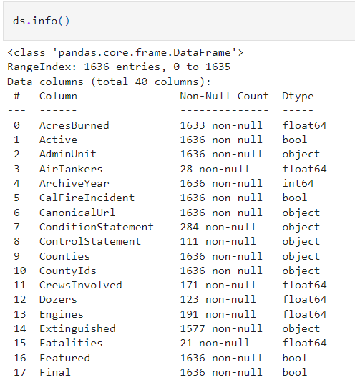
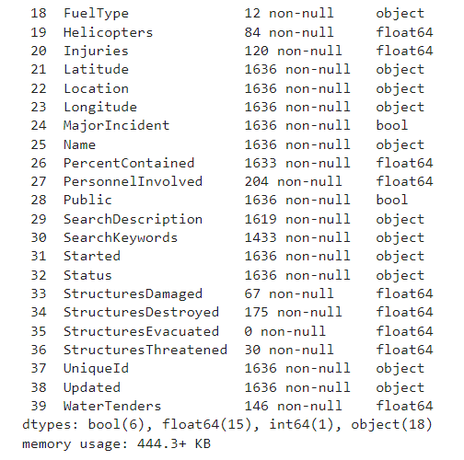
Before Data Cleaning

Slide 15
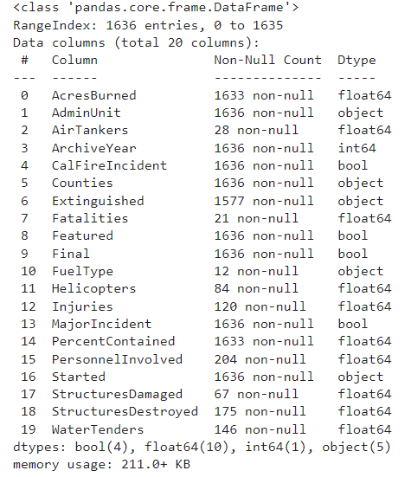
After Data Cleaning

Slide 16
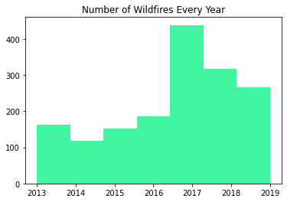
Histograph Showing Wildfires Each Year

Slide 17
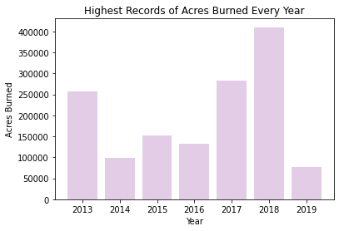
Bar Chart of Most Burned Acres Yearly

Slide 18
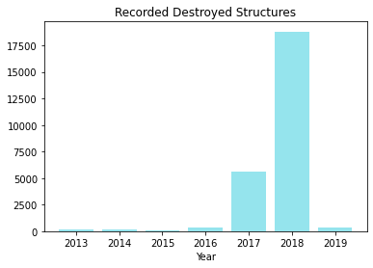
Recorded Destroyed Structures Yearly

Slide 19
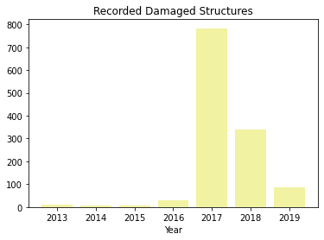
Recorded Damaged Structures Yearly

Slide 20
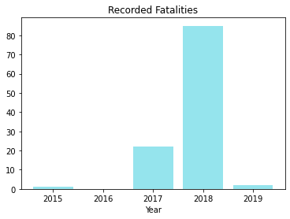
Recorded Fatalities

Slide 21
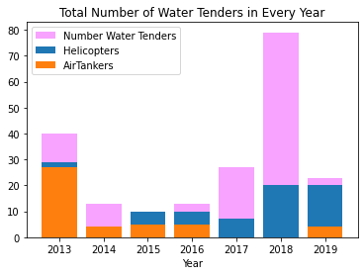
Number of Used Water Tenders Each Year

Slide 22
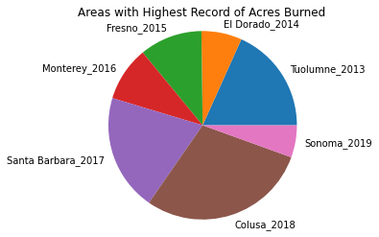
Areas With Highest Burned Acres on Each Year

Slide 23
THANK YOU!!

